Slide 1

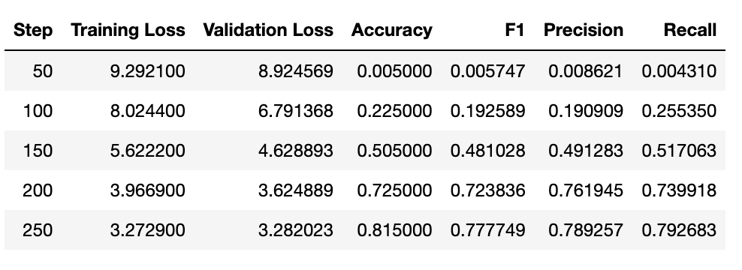
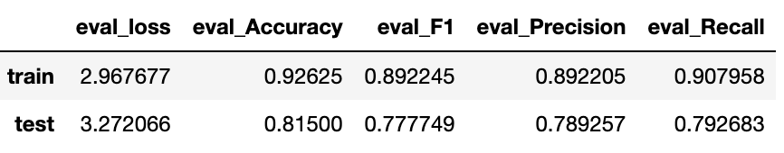
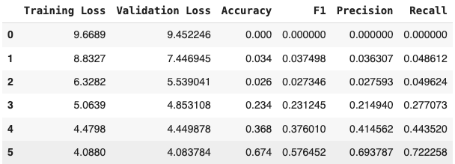

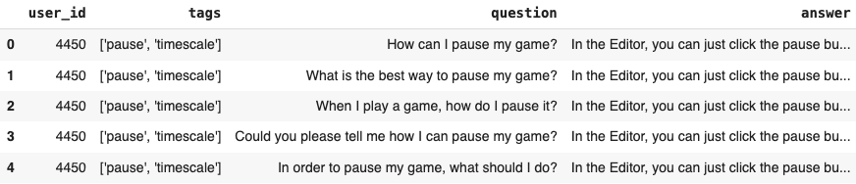
GameGuruBot: Chatbot with LLM’s – BERT & OPENAI-GPT
Hari Merla, Bhanuvardhan Reddy & Dr. John D. Osborne
Introduction:
Introducing GameGuruBot, your go-to chatbot for game development queries! From coding conundrums to design dilemmas, GameGuruBot has the answers to level up your game development journey.
Purpose :
Enhance gamers engagement
Provide instant responses
Streamline customer support
Model overview:
Bert – Understanding context
Bidirectional context:
Captures bidirectional relationships between words
Enhances context understanding in sentences
Fine-tuning for chatbot Tasks:
Pre-train Bert on large corpus
Fine-tune for specific chatbot-related tasks
2. Openai-GPT
Unidirectional context:
Captures bidirectional relationships between words
Fine-tuning for chatbot Tasks:
pre-trained using large language modeling on a large corpus with long range dependencies.
Flowchart:
Model Implementation
The dataset includes a collection of questions and their corresponding answers. To prepare the dataset, preprocessing steps are implemented to manage null values, tokenize the text, and assign labels to the data. This preprocessing ensures that the dataset is well-structured for subsequent tasks.
Subsequently, the model is trained using the trainer class from the transformers library, incorporating specific training arguments. During the evaluation phase, various metrics, such as accuracy, F1 score, precision, and recall, are employed to assess the model's performance.
Challenges:
Finding dataset
Lots of new unseen errors while tuning the dataset. For instance batch_size should not be greater than 1 and more.
Tuning
testing
GeneTerrain web application
train
BERT
BERT
Gamedev dataset
eval
Choose best model
test
Openai-gpt
Openai-gpt
Result:
Chatbot Bert Results
References
APA: Radford, A., Narasimhan, K., Salimans, T., & Sutskever, I. (2018). Improving language understanding by generative pre-training.
Anton Kozyriev. (2022). <i>Gamedev Chatbot: Domain-oriented intent dataset</i> [Data set]. Kaggle. https://doi.org/10.34740/KAGGLE/DS/1565666
Devlin, J., Chang, M.-W., Lee, K., & Toutanova, K. (2018). BERT: Pre-training of Deep Bidirectional Transformers for Language Understanding.CoRR,abs/1810.04805. http://arxiv.org/abs/1810.04805
Dataset:
Game dev
we looked for chatbot FAQ data in various platforms and found game dev dataset in Kaggle. Gamedev dataset is in json format. We performed data cleaning, feature extraction and converted it into csv format.
It contains 134183 entries with 5 columns of Id, User_id, tags, question and answer.
Using question as input feature and answer as output label.
Chatbot openai-gpt Results
More details
Chatbot with LLM’s – BERT & OPENAI-GPT

